Slide 1
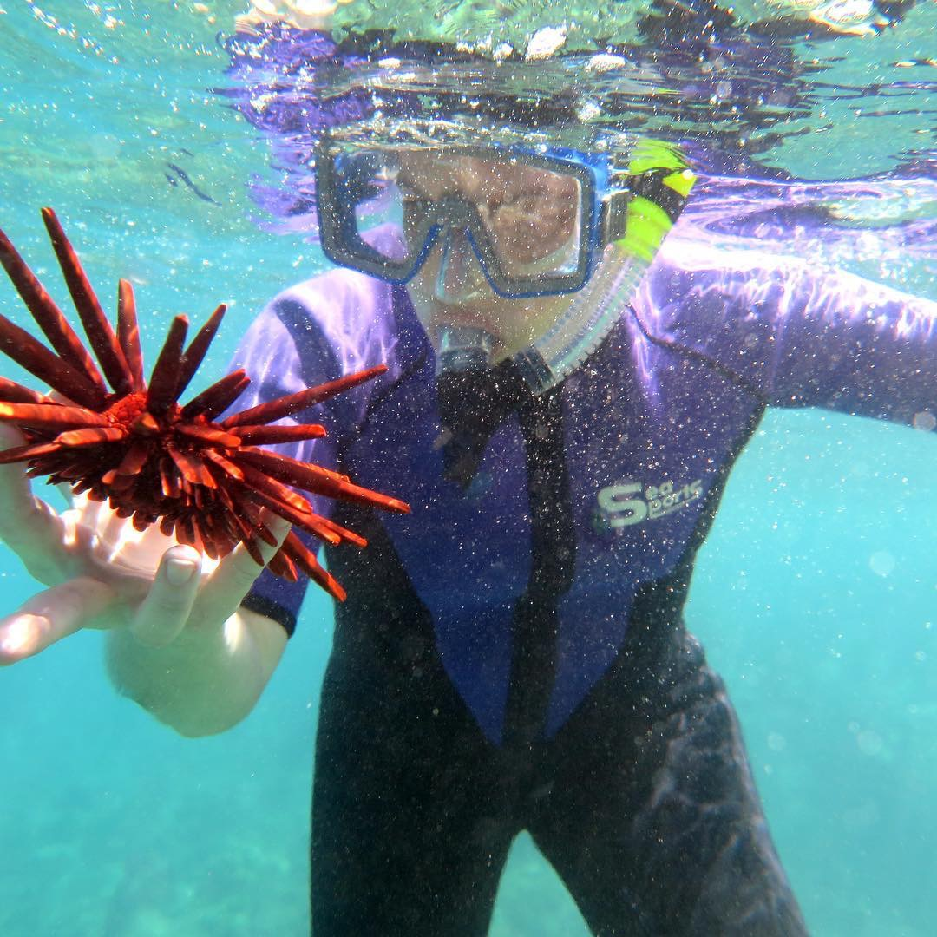
Daytime Graduate Programs Electrical & Computer Engineering
Brenda Larson, M.Ed.
Lead Academic Counselor, Graduate Programs
brenda16@uw.edu
Jennifer Huberman, M.Ed.
Graduate Advising Program Coordinator
grad@ece.uw.edu

Slide 2
Prof. M.P. (Anant) Anantram
Research Interests:
the theory, algorithm and application of modeling methods for nanoscale materials and devices
https://sites.uw.edu/anantmp/
B.Sc. in Applied Science from P.S.G. College of Technology, Coimbatore, India, his M.Sc. degree in Physics from the University of Pune, India, and his Ph.D. in Electrical Engineering from Purdue University. He has worked at the NASA Ames Research Center’s Center for Nanotechnology and was a professor at the University of Waterloo before joining the University of Washington.
Anantram’s group’s current focus is on fast algorithms to calculate Gless, modeling of electron transport in DNA and multi-scale modeling of memory devices such as phase change and resistive memory devices.

Slide 3
Prof. Amy Orsborn
Research Interests:
the intersection of engineering and neuroscience to develop therapeutic neural interfaces.
http://faculty.washington.edu/aorsborn/
Ph.D. at the UC Berkeley/UCSF Joint Graduate Program
in Bioengineering In her graduate program, Amy was developing co-adaptive strategies for brain-machine interfaces where machine-learning and neural adaptation collaborate to improve system performance. In her postdoctoral training at NYU’s Center for Neural Science, she developed novel neural implants for multi-scale, multi-modal interrogation and monitoring of neural circuits in non-human primates. These implants enable new ways to study neural mechanisms of learning in large-scale networks.
Dr. Orsborn’s lab explores neural interfaces as adaptive closed-loop systems that engage neural plasticity and adaptation.

Slide 4
Prof. Chet Moritz
Research Interests:
brain-computer interfaces and neural devices to treat paralysis: depts.washington.edu/moritlab
Ph.D. in Integrative Biology, University of California, Berkeley 2003
B.S. in Zoology, University of Washington, 1998 After his PhD, Chet completed post-doctoral training at the University of Colorado. A second post-doc at the University of Washington began his interest in brain-computer interfaces and neural devices to treat paralysis.
He is now an Associate Professor in the departments of Electrical & Computer Engineering, Rehabilitation Medicine, and Physiology & Biophysics.
Chet serves as the Co-Director for the Center for Neurotechnology, and NSF Engineering Research Center (ERC). He is also the founding director of the Washington Spinal Cord Injury Consortium (WASCIC), and directs the Restorative Technologies Laboratory (RTL) - which focuses on developing technologies to treat paralysis due to spinal cord injury.

Slide 5
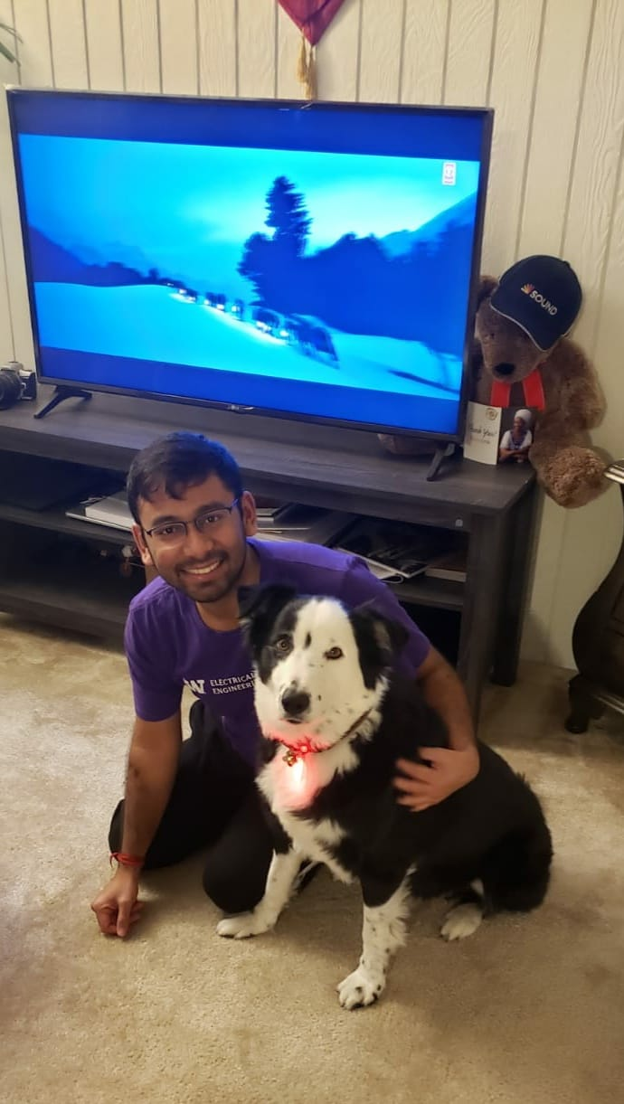
Graduate Student Guest – Rahul Mallik
PhD Program, and Graduate Student Association
Executive Board Member
Research Interests:
Power Electronics, working mainly in grid integration of renewable energy
Rahul is a second year PhD student working with Prof. Brian Johnson.
He received his MSEE from Indian Institute of Science, and his Bachelor of Engineering degree from Jadavpur University. Prior to joining UW, Rahul was Associate Scientist at ABB for their Research and Development wing in Chennai, India.
When not engaged in PhD pursuits, Rahul enjoys hiking, painting, writing and playing soccer.

Slide 6
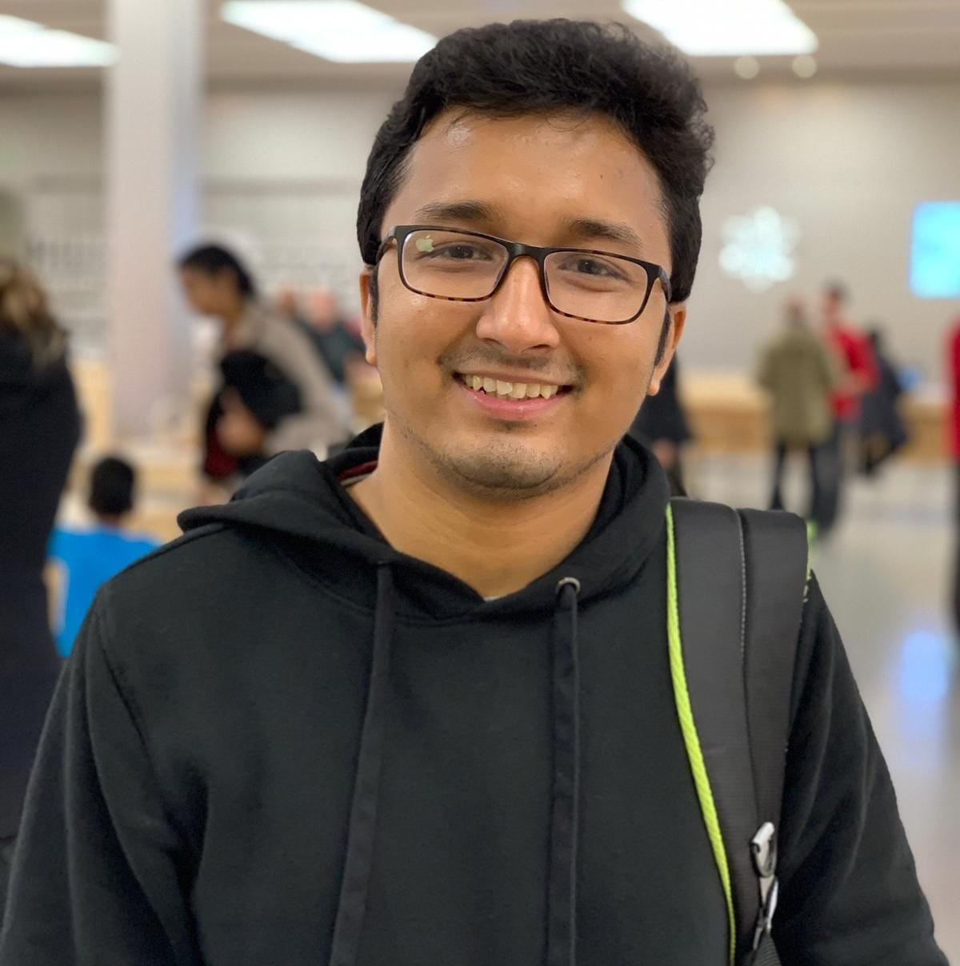
Graduate Student Guest – Soham Dutta
PhD Program, and Graduate Student Association
Executive Board Member
Research Interests:
Control of complex power electronics systems and medium voltage power converters
Soham is a second year PhD student working also with Prof. Brian Johnson.
Soham obtained his B.E and M.E degrees, respectively, from Jadavpur University, India in 2015 and the Indian Institute of Science in 2017, both in Electrical Engineering. Prior to joining UW, he was Project Associate for the Power Electronics Group at the Indian Institute of Science (IISc), Bangalore. As a Project Associate, he designed and developed a Digital Signal Processor (DSP) and FPGA based integrated hardware platform for power converter control and embedded applications.
When not engaged in PhD pursuits, Soham loves playing soccer and badminton.

Slide 7
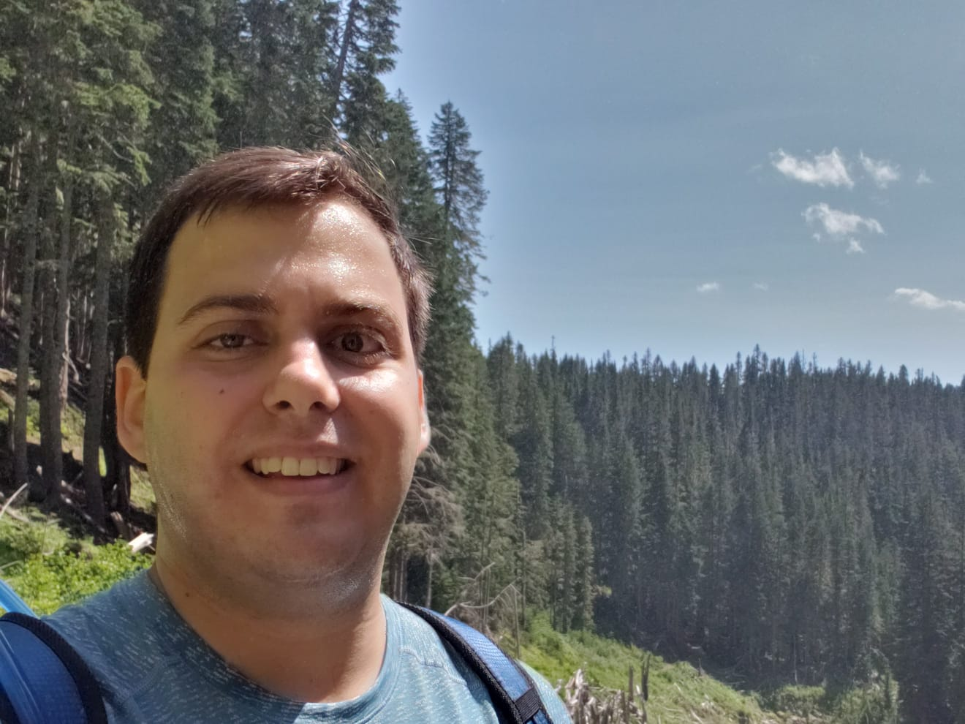
Graduate Student Guest – Diego Peña
PhD Program, and Graduate Student Association
Executive Board Member
Research Interests:
Digital Integrated Circuit (IC) Design, especially for Data Acquisition, Signal Processing, and Energy Efficient applications
Diego is a second year PhD student working with Prof. Visvesh Sathe.
He received his bachelor's degree in 2018 from Universidad Simón Bolívar (Caracas, Venezuela), and interned at CERN (Geneva, Switzerland) during the summer of 2016.
When not engaged in PhD pursuits, Diego enjoys watching soccer, reading novels, and playing games with friends .

Slide 8
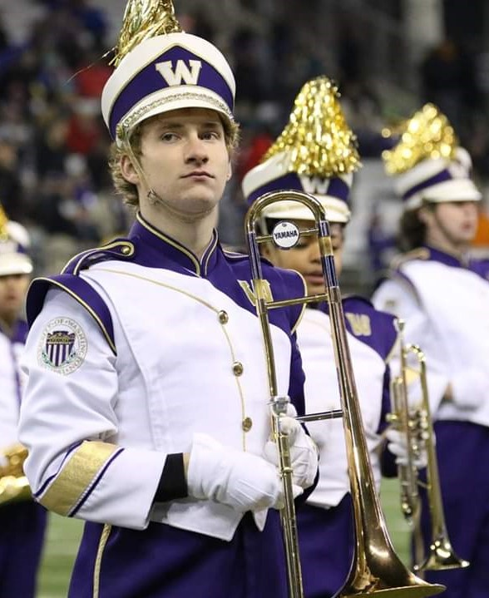
Graduate Student Guest – Mark Odendahl
MSEE (BS-MS Program) and Graduate Student Representative on ECE Curriculum Committee
Research Interests:
Digital Integrated Circuit (IC) Design, especially for Data Acquisition, Signal Processing, and Energy Efficient applications
Mark Odendahl is a 5th year combined BS/MS student in Professor Lih Lin's Photonics Group. His current research focus is on the patterning of perovskite to create closely packed LED arrays. This research is done jointly at the Photonics Research Center (PRC), Washington Nanofabrication Facility (WNF), and ECE Photonics Lab. Mark interned for two years at a company called Kymeta in Redmond, where they make metamaterial steered satellite antennas. Outside of research, Mark stays involved in the Husky Marching Band as an Alumni and enjoys spending free time with friends.

Slide 9
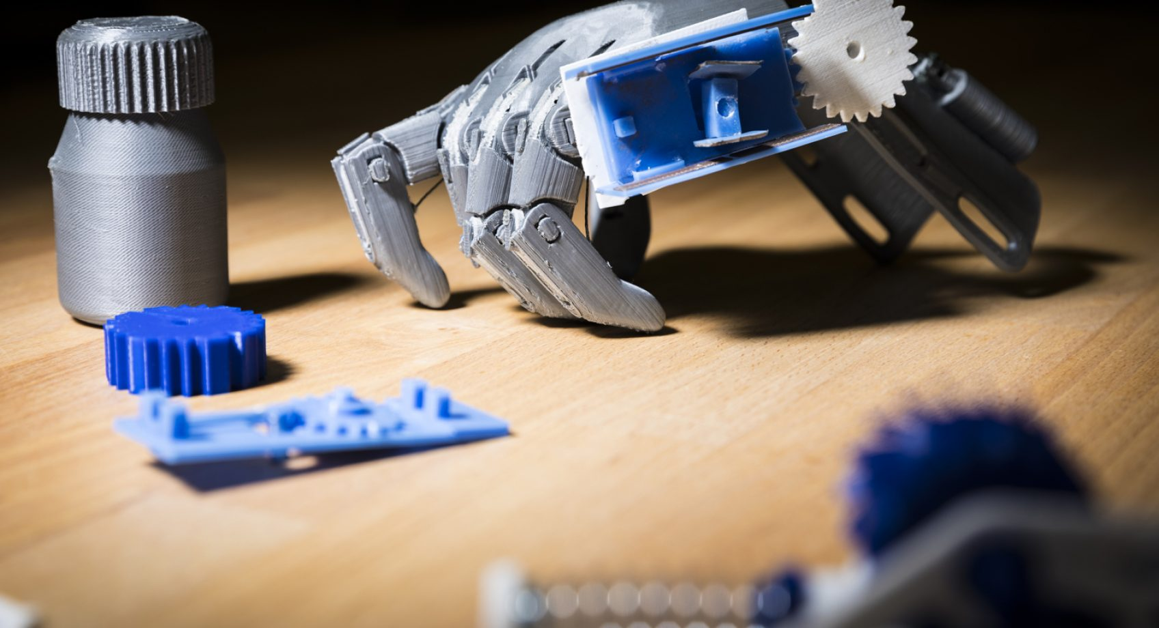
At a Glance: UW Electrical Engineering…
Ranked 18th for Engineering Doctorate programs and
Ranked 21st for Electrical Engineering and 10th for Computer Engineering among all national public universities by U.S. News and World Report for 2019.
Premier Electrical Engineering program in the Pacific Northwest
Largest department in the University of Washington’s College of Engineering
382 Graduate Students (Fall 2018)
215 MSEE (64 Daytime, 151 PMP)
167 PhD
52 Faculty
27 IEEE Fellows
14 NSF Career Awards

Slide 10
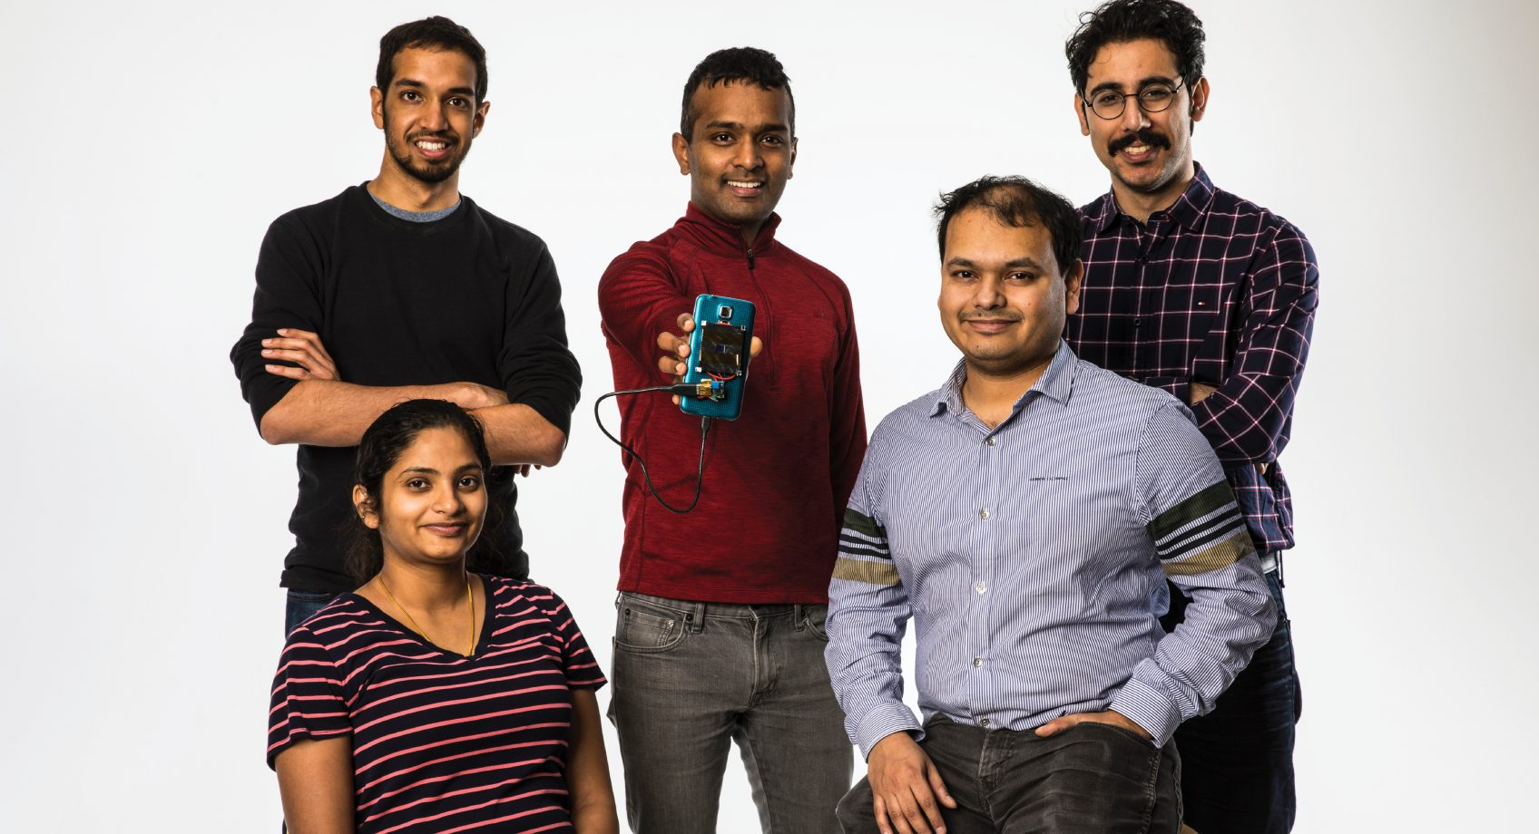
Research Areas
Computing and Networking: VLSI, Embedded Systems, Wireless Comm, Cybersecurity
Photonics and Nano Devices: Nanoscale Materials & Structure, Integrated Photonics & Optoelectronics, MEMS, Sensors & Sensor Systems
Power and Energy Systems: Power Systems, Power Electronics, Renewable Energy, Photovoltaics and Energy Harvesting
Robotics and Controls: Surgical & Bio-Robotics, Smart Cities, Haptics, Network Control Systems
BioSystems: Synthetic Biology, Neural Engineering, Medical Devices, Mobile Health
Data Sciences: Speech, Image and Video Processing

Slide 11
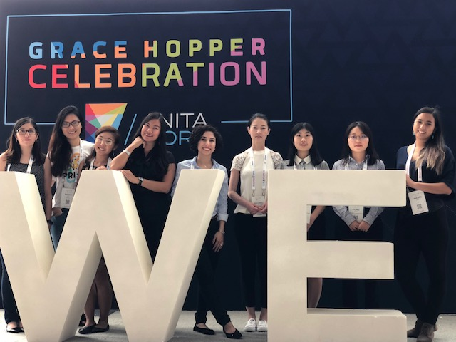
We are committed to diversity.
We value diversity in both our faculty and student base and exceed the national average of women in electrical and computer engineering:
Percentage of master’s degrees awarded to women:
National: 22.4%, UW EE: 23.3%
Percentage of Ph.D. degrees awarded to women:
National: 14.7%, UW EE: 16.7%
Percentage of women tenured and tenure-track faculty:
National: 12.4%, UW EE: 15.9%
Minorities make up one-fourth of our undergraduate and graduate school classes.

Slide 12
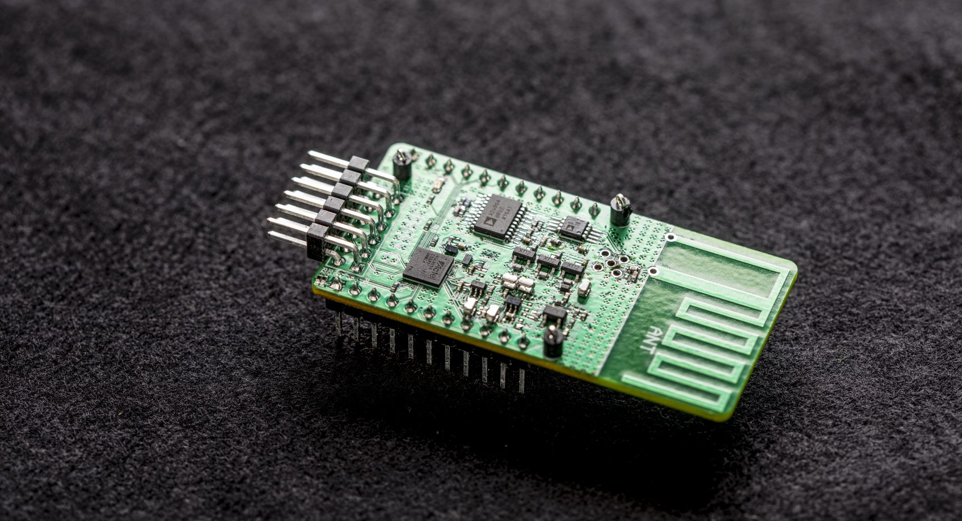
ECE Graduate Degree Programs
BS – MS (45 credits)
Coursework, Project or Thesis
Early entry: Apply in July, be admitted by August before your senior year
GRE not required
UW EE students apply summer after their junior year
3.7 Cumulative GPA required
Students may earn up to 9 credits of graduate credit during their senior year to apply towards MSEE degree

Slide 13
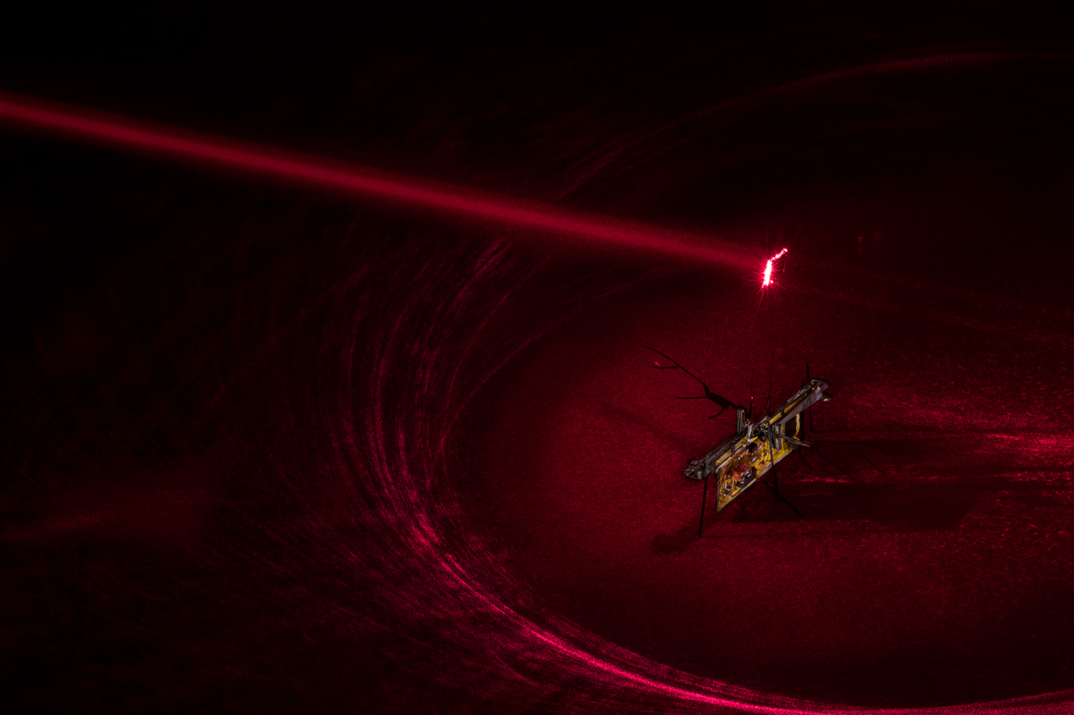
ECE Graduate Degree Programs
MSEE (42 credits)
Coursework or Thesis Options
Option to Continue to PhD
PhD (90 credits)
27 thesis credits required
For students with a Master’s, 30 credits can be counted toward the 90-credit degree requirement.
Can earn MS on way to PhD

Slide 14
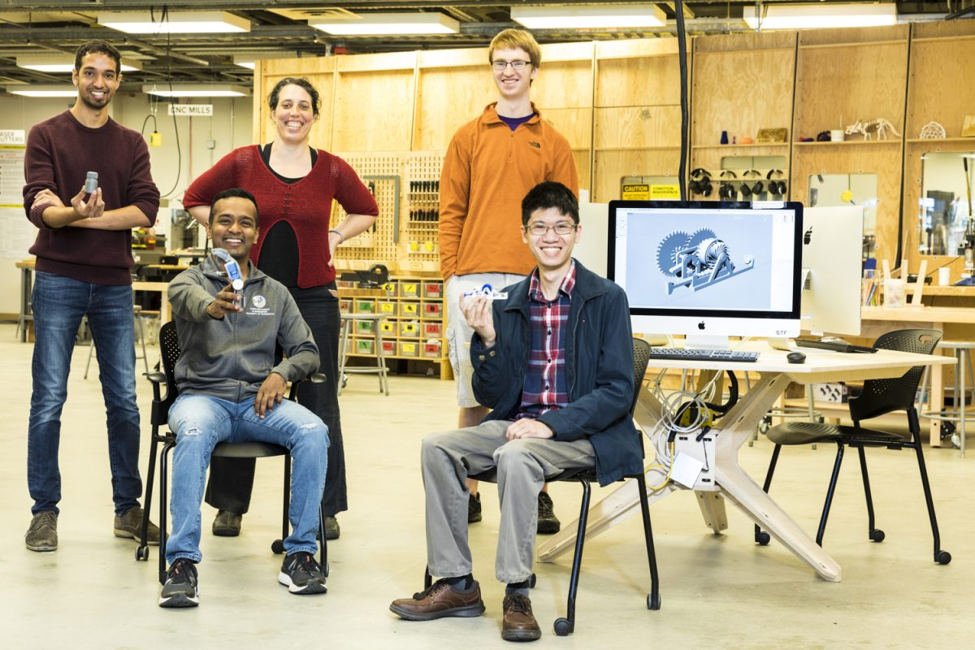
ECE Graduate Degree
Programs
MSEE & PhD Admission
Apply by December 15, for admission the following autumn
Notification by following March
April 15 is national deadline for accepting offers
GRE Optional, no longer required

Slide 15
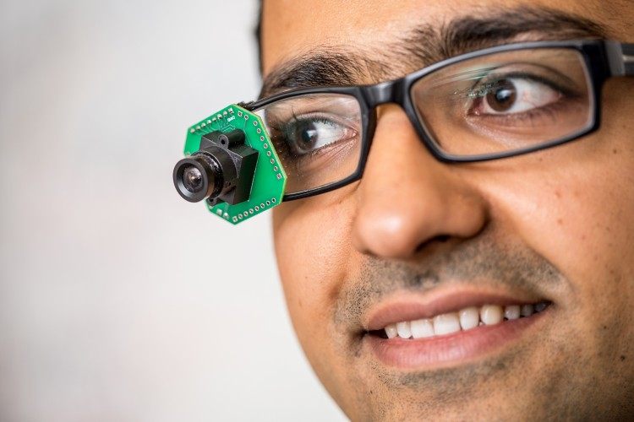
ECE Graduate Degree Programs
MSEE & PhD Admission - continued
3.0 Cumulative GPA required; 3.5 GPA recommended for competitive application
BSEE students may earn up to 6 credits of graduate credit during their final quarter of undergrad degree, to apply towards MSEE degree.
TOEFL
International applicants are required to take TOEFLiBT (minimum score 92 includes all 4 sections).
With a 4 year Bachelor’s degree in US or English taught institution, TOEFL is waived.

Slide 16
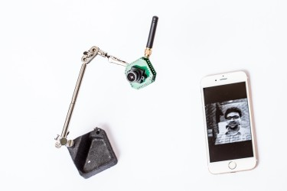
ECE Graduate Degree Programs
MSEE & PhD Admission - continued
Keep in mind…
Applications received after the deadline will not be considered
All application materials submitted electronically
Applications accepted once per year for admission in the following Autumn
Application Materials:
Online UW Graduate School Application
Application fee ($85; paid online)
Resume or CV
Unofficial Transcripts
Statement of Purpose
Three (3) Letters of Recommendation
(2 nominations for BS-MS)
Personal Statement (US only - optional)
TOEFL (non-native English speaking applicants)

Slide 17
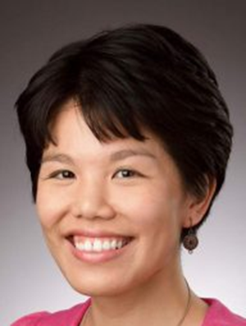
ECE Graduate Degree Programs
Professional Master’s Program – MSEE (45 credits)
Coursework Only
Industry focused curriculum
Courses in the evening (allowing time for work or internship during the day)
Full time or Part time options
Sample Courses Include: Data Sciences for Power Systems, The Self-Driving Car, Embedded and Real-time Systems, Machine Learning for Big Data, and Wireless Networking for 5G
Admission
Early deadline is January 5 – notification prior to April 15th national deadline
Regular deadline is May 15 – notification in June/July
No GRE required
Information Session – TBA – check with May Lim at: smlim@uw.edu

Slide 18
No Degree in ECE?
Students with a strong academic record who hold
a B.S. degree in a technical field such as mathematics, physics, chemistry, computer science or in another branch of engineering can expect to perform well in the Department's MSEE or PhD Programs provided they first develop a basic background in electrical engineering.
Fundamental courses recommended of all non-EE degree holders are:
EE 215 "Fundamentals of Electrical Engineering"
EE 233 "Circuit Theory"
EE 235 "Continuous Time Linear Systems"
Optional – EE 271 "Digital Circuits and Systems"
Programming skills at the level of CSE 142 "Computer Programming I" and CSE 143 "Computer Programming II"

Slide 19
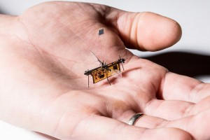
Funding
PhD & Master’s Program info
All PhD students will be provided departmental support for a total of 4 academic years. Funding may include Teaching or Research Assistant positions, Fellowships and Departmental support.
TA/RA 50% FTE appointments come with full tuition waivers, a modest monthly stipend (currently $2758), and health benefits. Students can expect to pay approximately $327 in fees per quarter.
International applicants must demonstrate spoken English proficiency for TA positions (per Memo 15 – Speak score of 26).

Slide 20
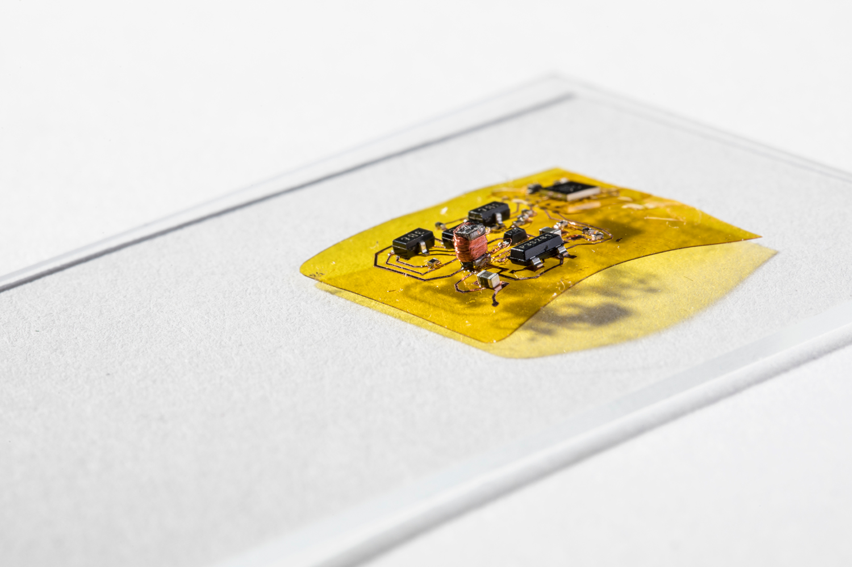
Funding - continued
PhD & Master’s Program info
MS applicants are encouraged to apply for fellowships and grants on their own. Some may also receive funding support from the department, however this is not guaranteed.
MS students are encouraged to apply quarterly for TA positions in ECE, other engineering departments or any area in which they feel qualified (Math, Physics). All TA positions include a Tuition Waiver, Healthcare & monthly stipend.
Unfortunately, we cannot make funding offers to all students.
There is no additional application for departmental funding (TA applications are announced later).

Slide 21
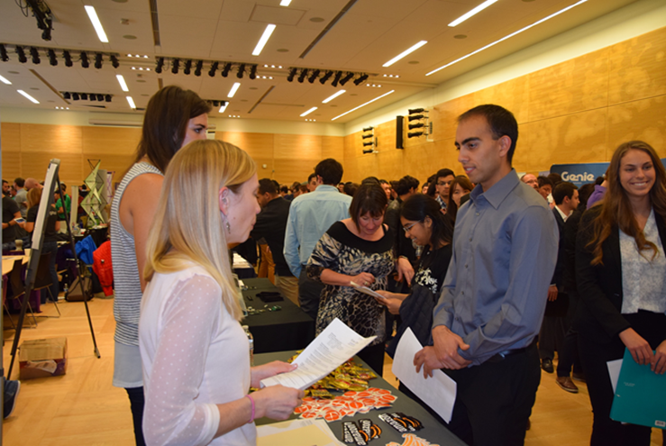
Student Life
ECE Graduate Student Association
Friday Socials and other fun events
IEEE Student Chapter – Industry Events
NEW! Women in Engineering Chapter
Women in Science & Engineering and Grace Hopper Conference Sponsorships
Society of Women Engineers
ECE Casino Night and Engineering Career Fair
Business Plan & EIC Competitions
College of Engineering Student Groups

Slide 22
Student Awards
Microsoft PhD Fellowship
Microsoft Ada Lovelace Fellowship
Intel PhD Fellowship
NASA Space Technology Research Fellowship
National Science Foundation Fellowships
Many more…

Slide 23
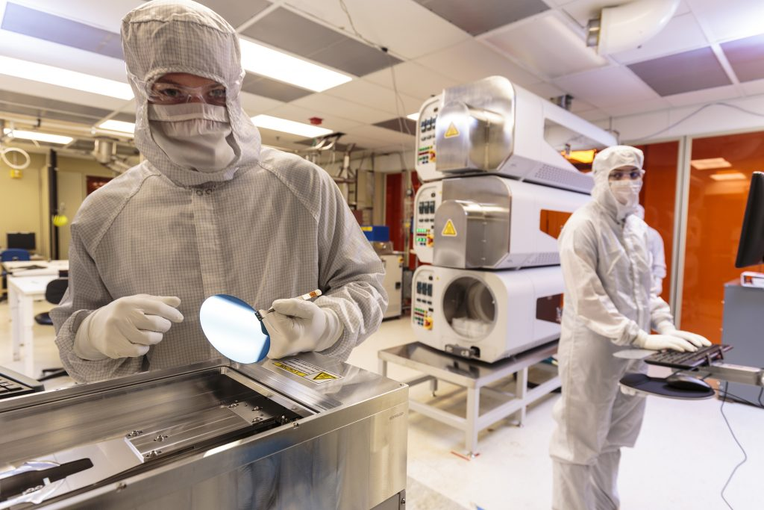
Questions?
Brenda Larson, Lead Graduate Programs Advisor
brenda16@uw.edu
Jennifer Huberman, Grad Advising Program Coordinator
grad@ece.uw.edu
Prospective Student Drop In Sessions: Fridays, 2:30-3:30pm in ECE Main Office
Website: www.ece.uw.edu

